Slide 1

DA
T
A A
NA
L
YST
Yijun Wang
ALY 6000

Slide 2

[non] someone who does precision guesswork based on unreliable data provided by those of questionable knowledge.
Data
Analytics
Notes:
menu

Slide 3
Data Mining
Reporting
Collate available data
Relevant to the project,
Normalize it at desired granularity
Communicating key finding with the stakeholders
Mission
Data Processing
Data Visualization
Cleaning data, transformations and feature engineering
Create interactive charts & dashboard for easier understanding of results
Notes:
DA’s mission

Slide 4
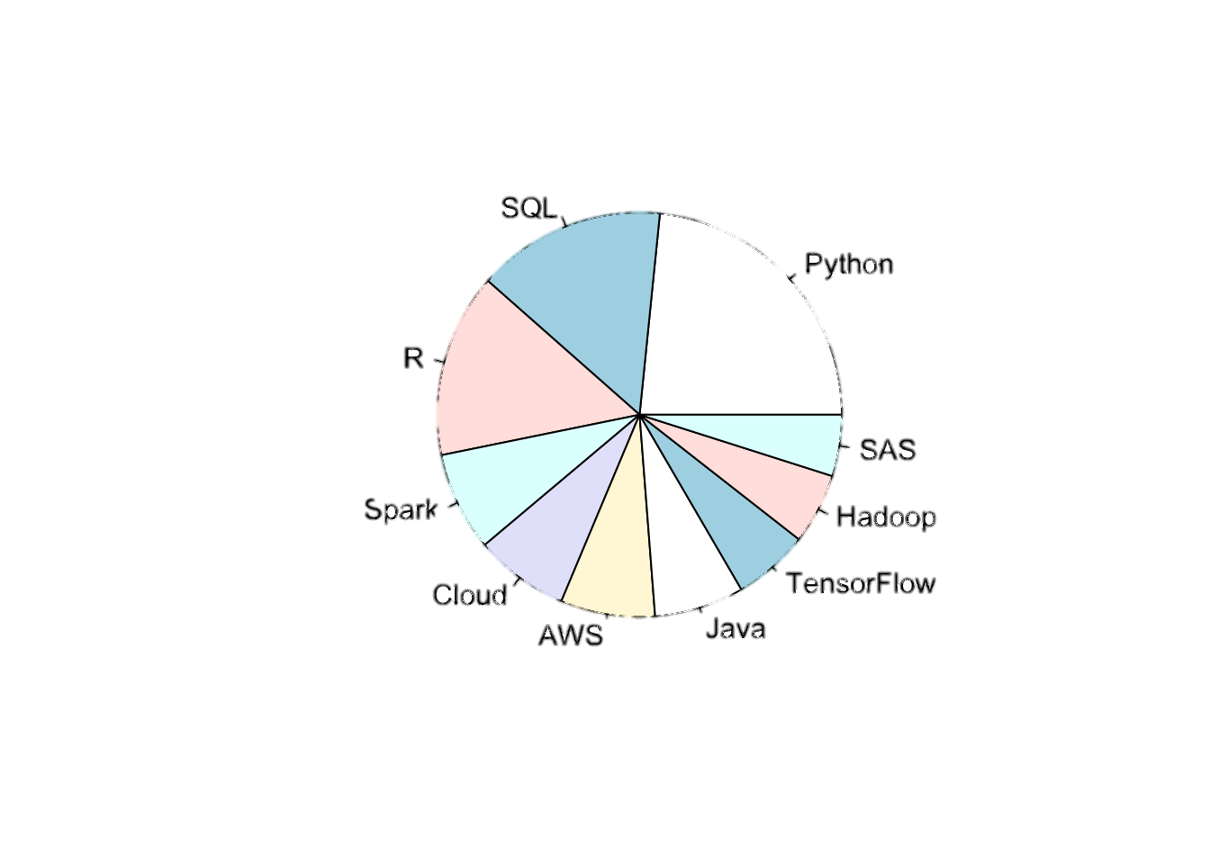
Core Skills
Tableau
Excel
SQL
R
Python
50%
40%
30%
20%
10%
References”
https://towardsdatascience.com/most-in-demand-tech-skills-for-data-analysts-26d4ea4450f8
http://www.randalolson.com/2016/03/24/the-correct-way-to-use-pie-charts/
0%
26%
45%
24%
21%
53%
Notes:
Skills of DA

Slide 5
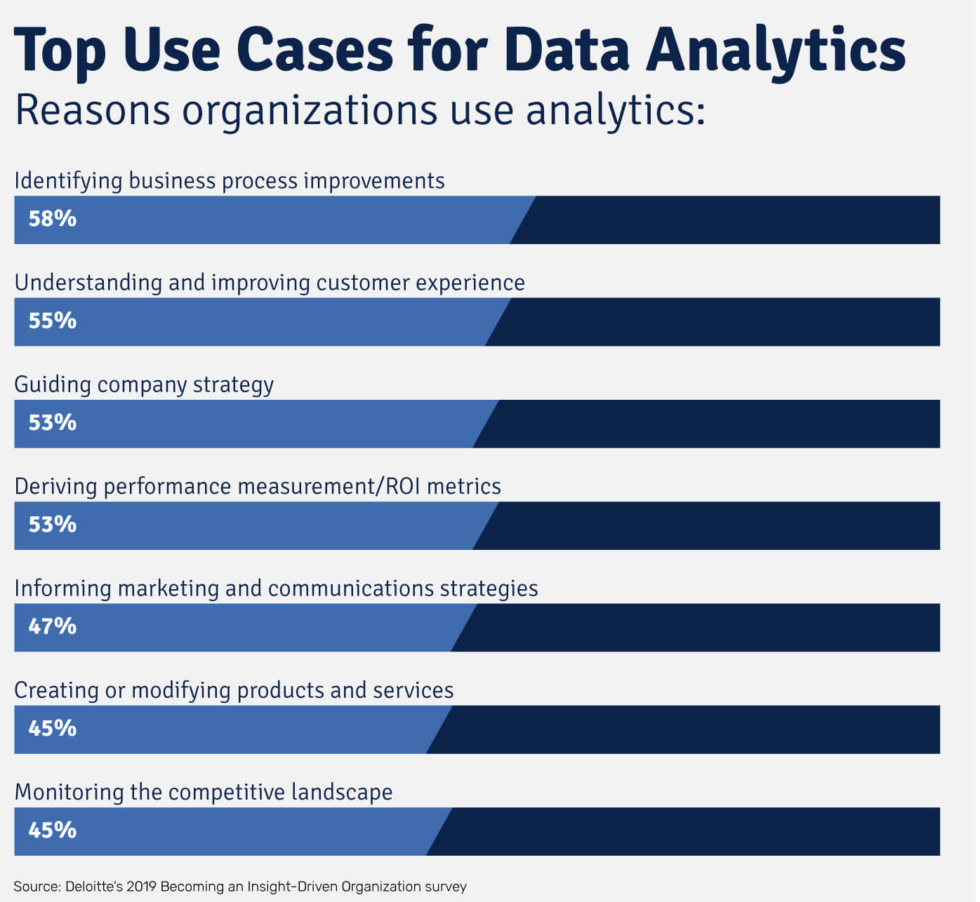
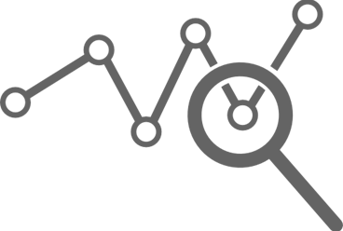
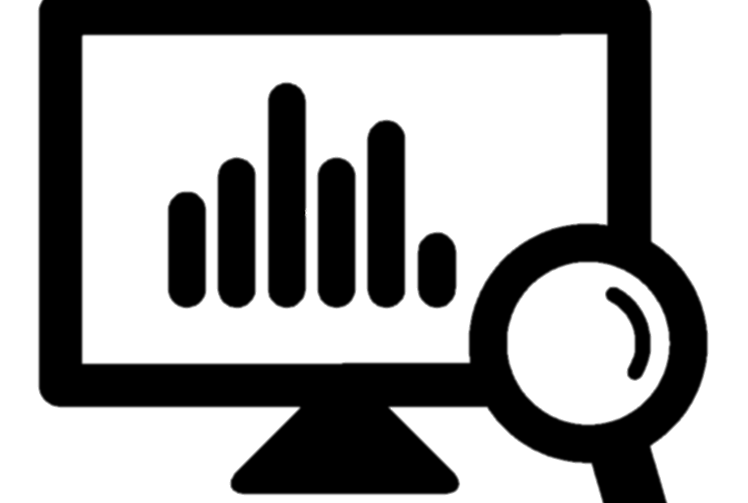
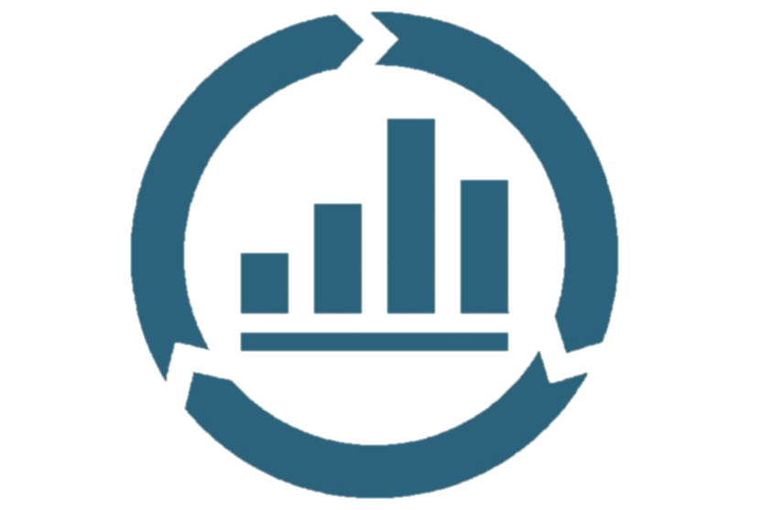
Collect
Step 1
Organize
Step 2
Analyze
Step 3
References”
https://www2.deloitte.com/us/en/insights/topics/analytics/insight-driven-organization.html
Notes:
DA Responsibilities/ Job description/importance of the job/公司使用DA得原因

Slide 6
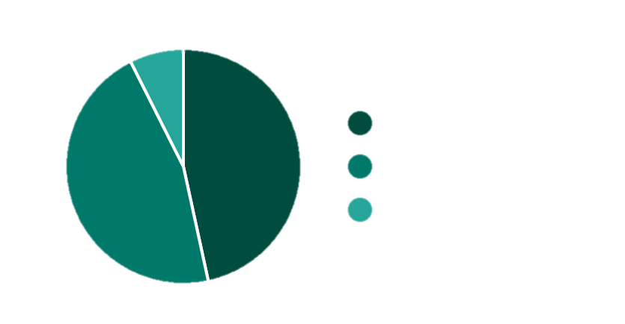
over 80,000 Data Analysts
Male Female
46.6% 46.0%
7.4%
Male
Female
46.6%
Unknow
46.0%
6.86%
5.00%
UNEMPLOYMENT
4.96%
4.70%
RATE
4.15%
3.56%
3.57%
3.12%
3.13%
2010
2011
2012
2013
2014
2015
2016
2017
2018
References”
https://www.zippia.com/data-analyst-jobs/demographics/
https://www.morningfuture.com/en/2018/02/21/data-analyst-data-scientist-big-data-work/
Notes:
DA每年需求/future demand

Slide 7
01
Average salary for Entry-Level
$36, 998- $ 79,400
data analysts on average
Average salary for Mid-Level
$41,256 - $ 92,976
$
94,280
02
03
Average salary for Senior-Level
$40, 831 - $101,273
References”
https://hackr.io/blog/data-analyst-salary
https://www.janbasktraining.com/blog/business-analyst-vs-data-analyst/
Notes:
Salary

Slide 8


Today, virtually every modern business has access to a wealth of data — so much so that their collected troves are impossible to use without experienced professionals. Thanks to data analysts with a clear understanding of how to deploy data-driven insights, however, the benefits of collecting those information troves are hard to understate.
Thank you

